Slide 1

Segmentation 세그멘테이션
문학준
2022/09/27

Slide 2
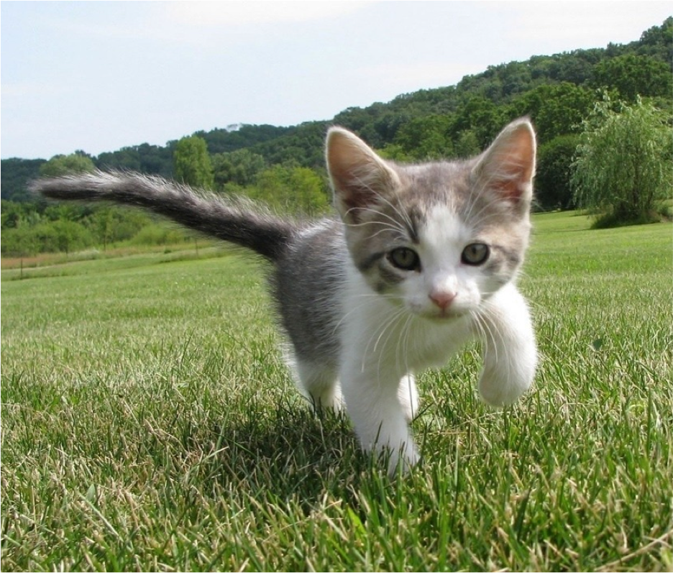
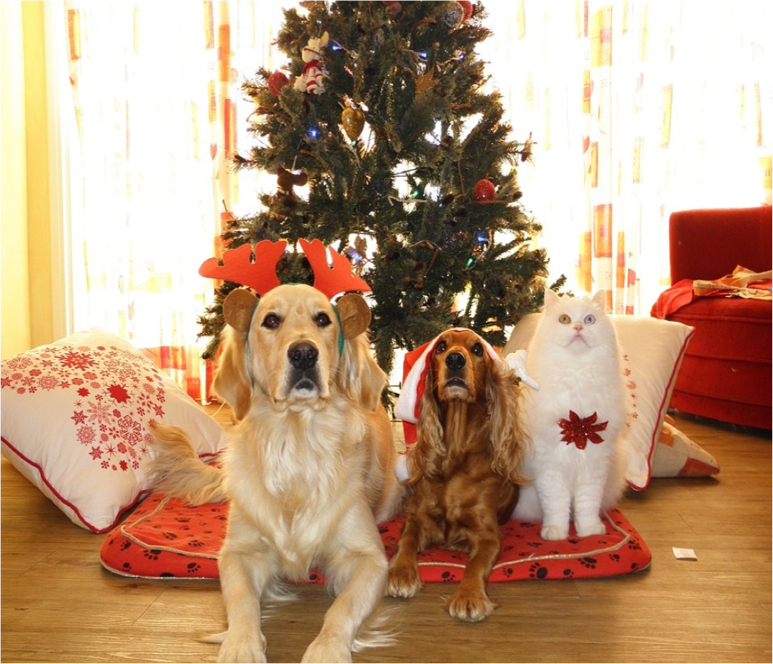
Segmentation
Semantic Segmentation
Instance Segmentation
GRASS, CAT, TREE, SKY
DOG, DOG, CAT

Slide 3
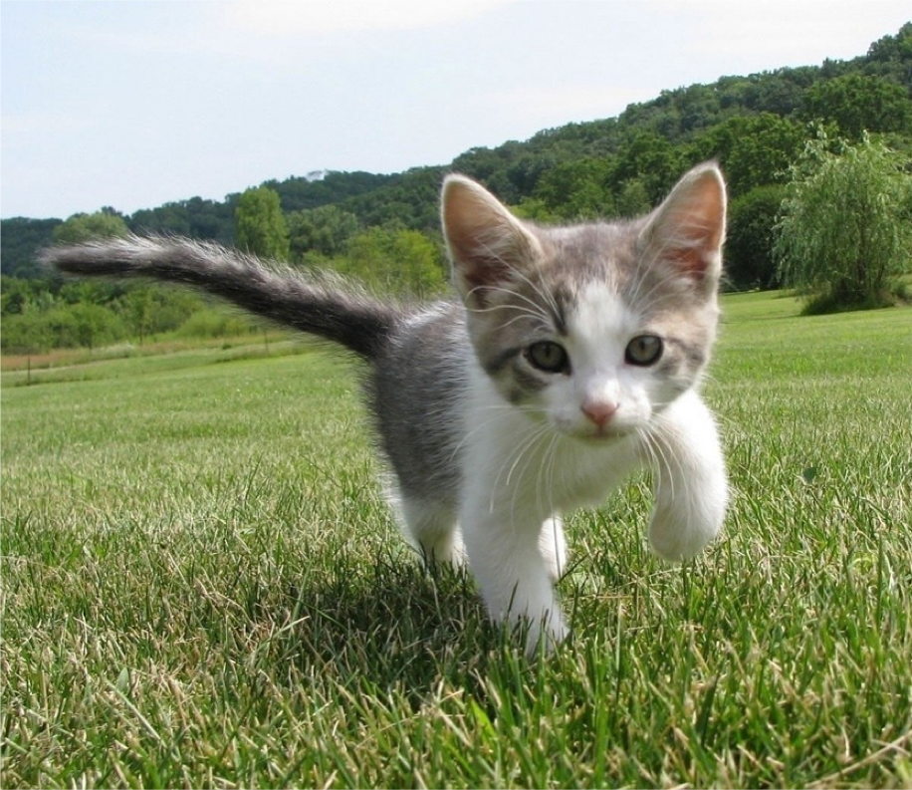
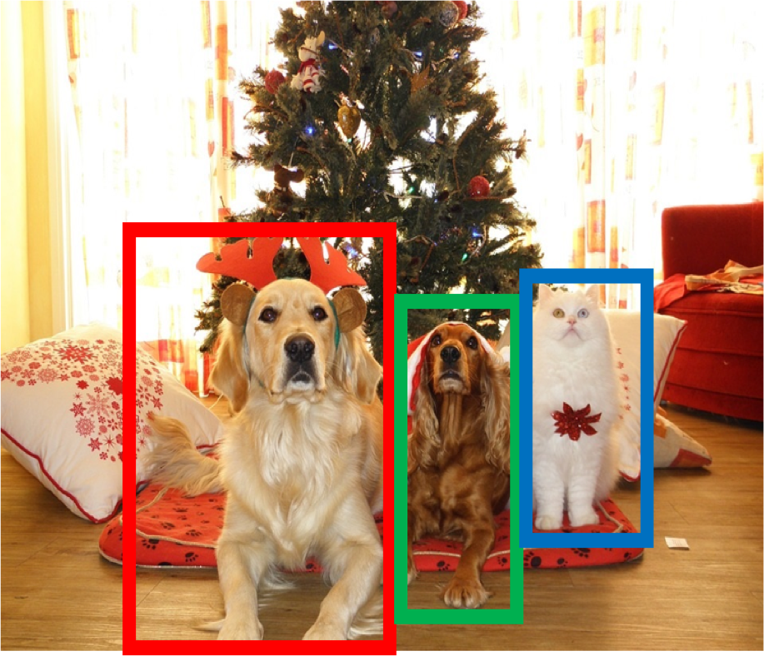
Computer Vision Tasks: Semantic Segmentation
Semantic Segmentation
Object Detection
Instance Segmentation
Classification
CAT
GRASS, CAT, TREE, SKY
DOG, DOG, CAT
DOG, DOG, CAT
No spatial extent
No objects, just pixels
Multiple Objects

Slide 4

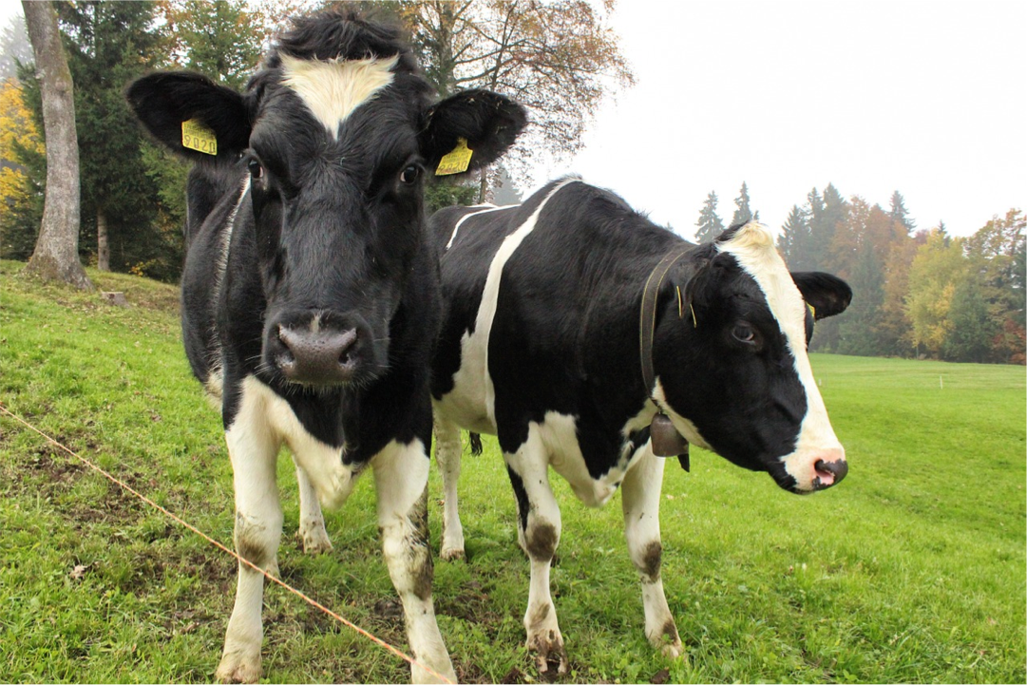
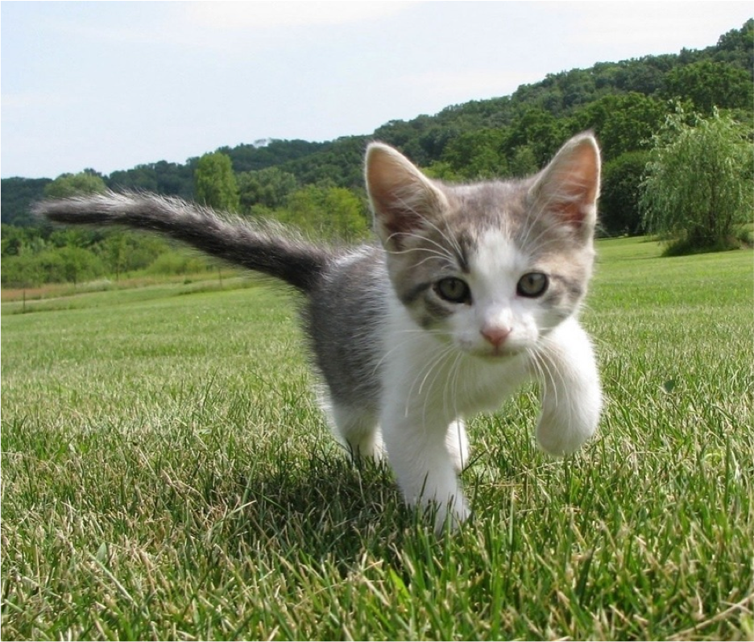
Semantic Segmentation
이미지의 각 픽셀을 라벨링
각 인스턴스를 구분하지는 않고, 픽셀에 대해서만 구분
Sky
Sky
Cow
Grass
Trees
Trees
Cat
Grass
This image is CC0 public domain

Slide 5
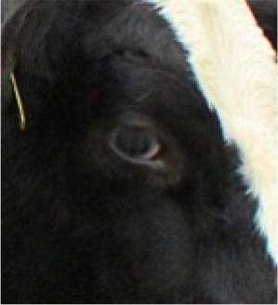
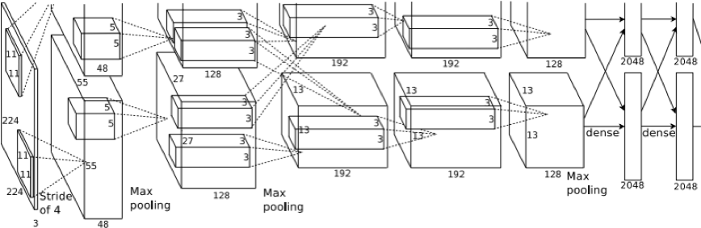
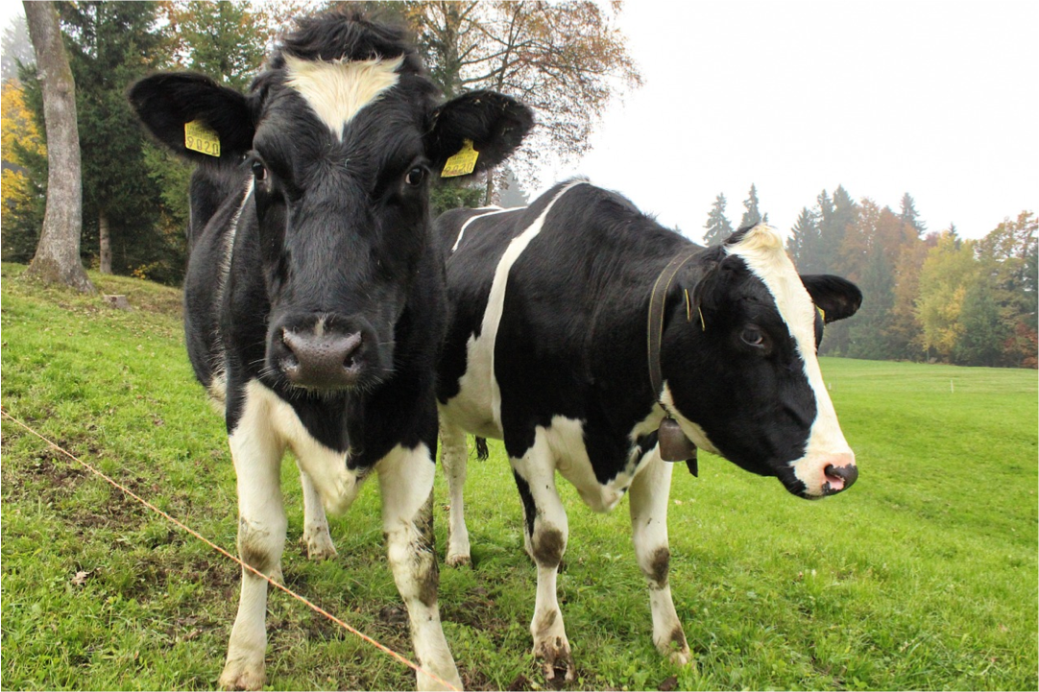

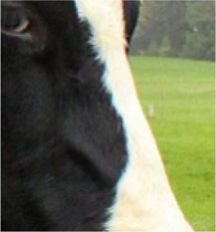
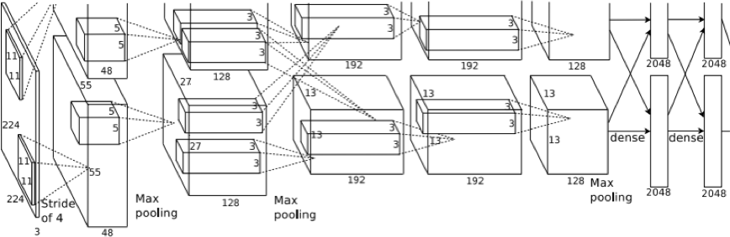

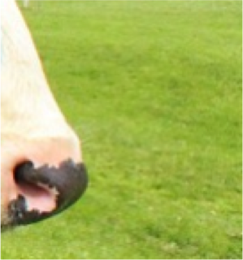
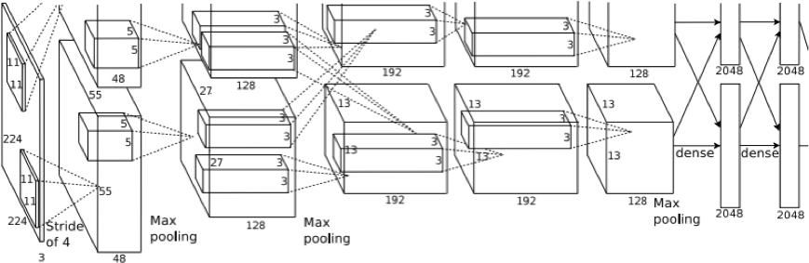

Semantic Segmentation Idea: Sliding Window
Extract patch
Classify center pixel with CNN
Full image
Cow
Cow
Grass
Problem: Very inefficient! Not reusing shared features between overlapping patches
Farabet et al, “Learning Hierarchical Features for Scene Labeling,” TPAMI 2013
Pinheiro and Collobert, “Recurrent Convolutional Neural Networks for Scene Labeling”, ICML 2014

Slide 6
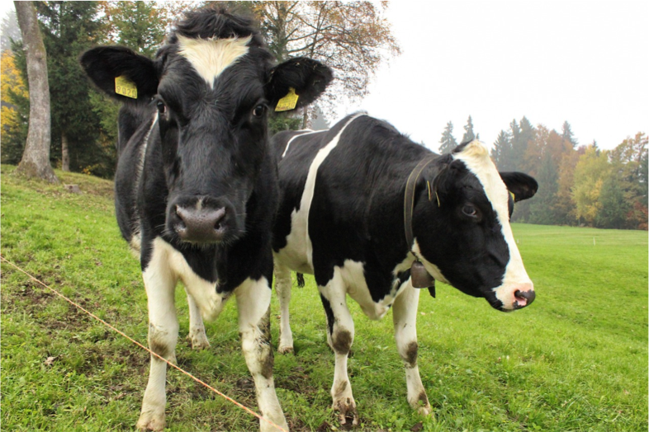
Semantic Segmentation: Fully Convolutional Network
Design a network as a bunch of convolutional layers to make predictions for pixels all at once!
Conv
Conv
Conv
Conv
argmax
Input: 3 x H x W
Scores: C x H x W
Predictions: H x W
Convolutions: D x H x W
Loss function: Per-Pixel cross-entropy
Long et al, “Fully convolutional networks for semantic segmentation”, CVPR 2015

Slide 7
Semantic Segmentation: Fully Convolutional Network
Design a network as a bunch of convolutional layers to make predictions for pixels all at once!
Conv
Conv
Conv
Conv
argmax
Input: 3 x H x W
Problem #1: Effective receptive field size is linear in number of conv layers: With L 3x3 conv layers, receptive field is 1+2L
Problem #2: Convolution on high res images is expensive! Recall ResNet stem aggressively downsamples
Long et al, “Fully convolutional networks for semantic segmentation”, CVPR 2015

Slide 8
Semantic Segmentation: Fully Convolutional Network
Downsampling: Pooling, strided convolution
Design network as a bunch of convolutional layers, with
Upsampling:
???
downsampling and upsampling inside the network!
Med-res: D₂ x H/4 x W/4
Med-res: D₂ x H/4 x W/4
Low-res:
D₃ x H/4 x W/4
Input: 3 x H x W
High-res: D₁ x H/2 x W/2
High-res: D₁ x H/2 x W/2
Predictions: H x W

Slide 9
In-Network Upsampling: “Unpooling”
Bed of Nails Nearest Neighbor
1 | 0 | 2 | 0
0 | 0 | 0 | 0
3 | 0 | 4 | 0
0 | 0 | 0 | 0
1 | 1 | 2 | 2
1 | 1 | 2 | 2
3 | 3 | 4 | 4
3 | 3 | 4 | 4
1 | 2
3 | 4
1 | 2
3 | 4
Input C x 2 x 2
Output C x 4 x 4
Input C x 2 x 2
Output C x 4 x 4

Slide 10


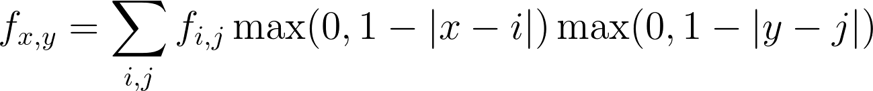
In-Network Upsampling: Bilinear Interpolation
1.00 | 1.25 | 1.75 | 2.00
1.50 | 1.75 | 2.25 | 2.50
2.50 | 2.75 | 3.25 | 3.50
3.00 | 3.25 | 3.75 | 4.00
1 | 2
3 | 4
Input: C x 2 x 2
Output: C x 4 x 4
Use two closest neighbors in x and y to construct linear approximations

Slide 11
In-Network Upsampling: Bicubic Interpolation
0.68 | 1.02 | 1.56 | 1.89
1.35 | 1.68 | 2.23 | 2.56
2.44 | 2.77 | 3.32 | 3.65
3.11 | 3.44 | 3.98 | 4.32
1 | 2
3 | 4
Input: C x 2 x 2 Output: C x 4 x 4
Use three closest neighbors in x and y to construct cubic approximations
(This is how we normally resize images!)

Slide 12
In-Network Upsampling: “Max Unpooling”
Max Pooling: Remember which position had the max
Max Unpooling: Place into remembered positions
1 | 2 | 6 | 3
3 | 5 | 2 | 1
1 | 2 | 2 | 1
7 | 3 | 4 | 8
0 | 0 | 2 | 0
0 | 1 | 0 | 0
0 | 0 | 0 | 0
3 | 0 | 0 | 4
5 | 6
7 | 8
Rest of net
Pair each downsampling layer with an upsampling layer
1 | 2
3 | 4
Noh et al, “Learning Deconvolution Network for Semantic Segmentation”, ICCV 2015

Slide 13
Semantic Segmentation: Fully Convolutional Network
Design network as a bunch of convolutional layers, with
downsampling and upsampling inside the network!
Upsampling: Iinterpolation, transposed conv
Downsampling: Pooling, strided convolution
Med-res: D₂ x H/4 x W/4
Med-res: D₂ x H/4 x W/4
Low-res:
D₃ x H/4 x W/4
Input: 3 x H x W
High-res: D₁ x H/2 x W/2
High-res: D₁ x H/2 x W/2
Predictions: H x W
Loss function: Per-Pixel cross-entropy

Slide 14
Things and Stuff
Things: 객체로 분류될 수 있는 카테고리
(e.g. cats, cars, person)
Stuff: (배경에 존재하기 때문에) 객체로 분류될 수 없는 카테고리
(e.g. sky, grass, water, trees)
Sky
Sky
Cow
Grass
Trees
Trees
Cat
Grass
This image is CC0 public domain

Slide 15

Computer Vision Tasks
Object Detection: 객체를 분류하고 박스로 구분 (Only things)
Semantic Segmentation: 픽셀마다 라벨링을 하지만, 객체를 서로 구분하지는 않음 (Both things and stuff)
Sky
Cow
Grass
Trees

Slide 16
Computer Vision Tasks: Instance Segmentation
Semantic Segmentation
Object Detection
Instance Segmentation
Classification
CAT
GRASS, CAT, TREE, SKY
DOG, DOG, CAT
DOG, DOG, CAT
No spatial extent
No objects, just pixels
Multiple Objects

Slide 17
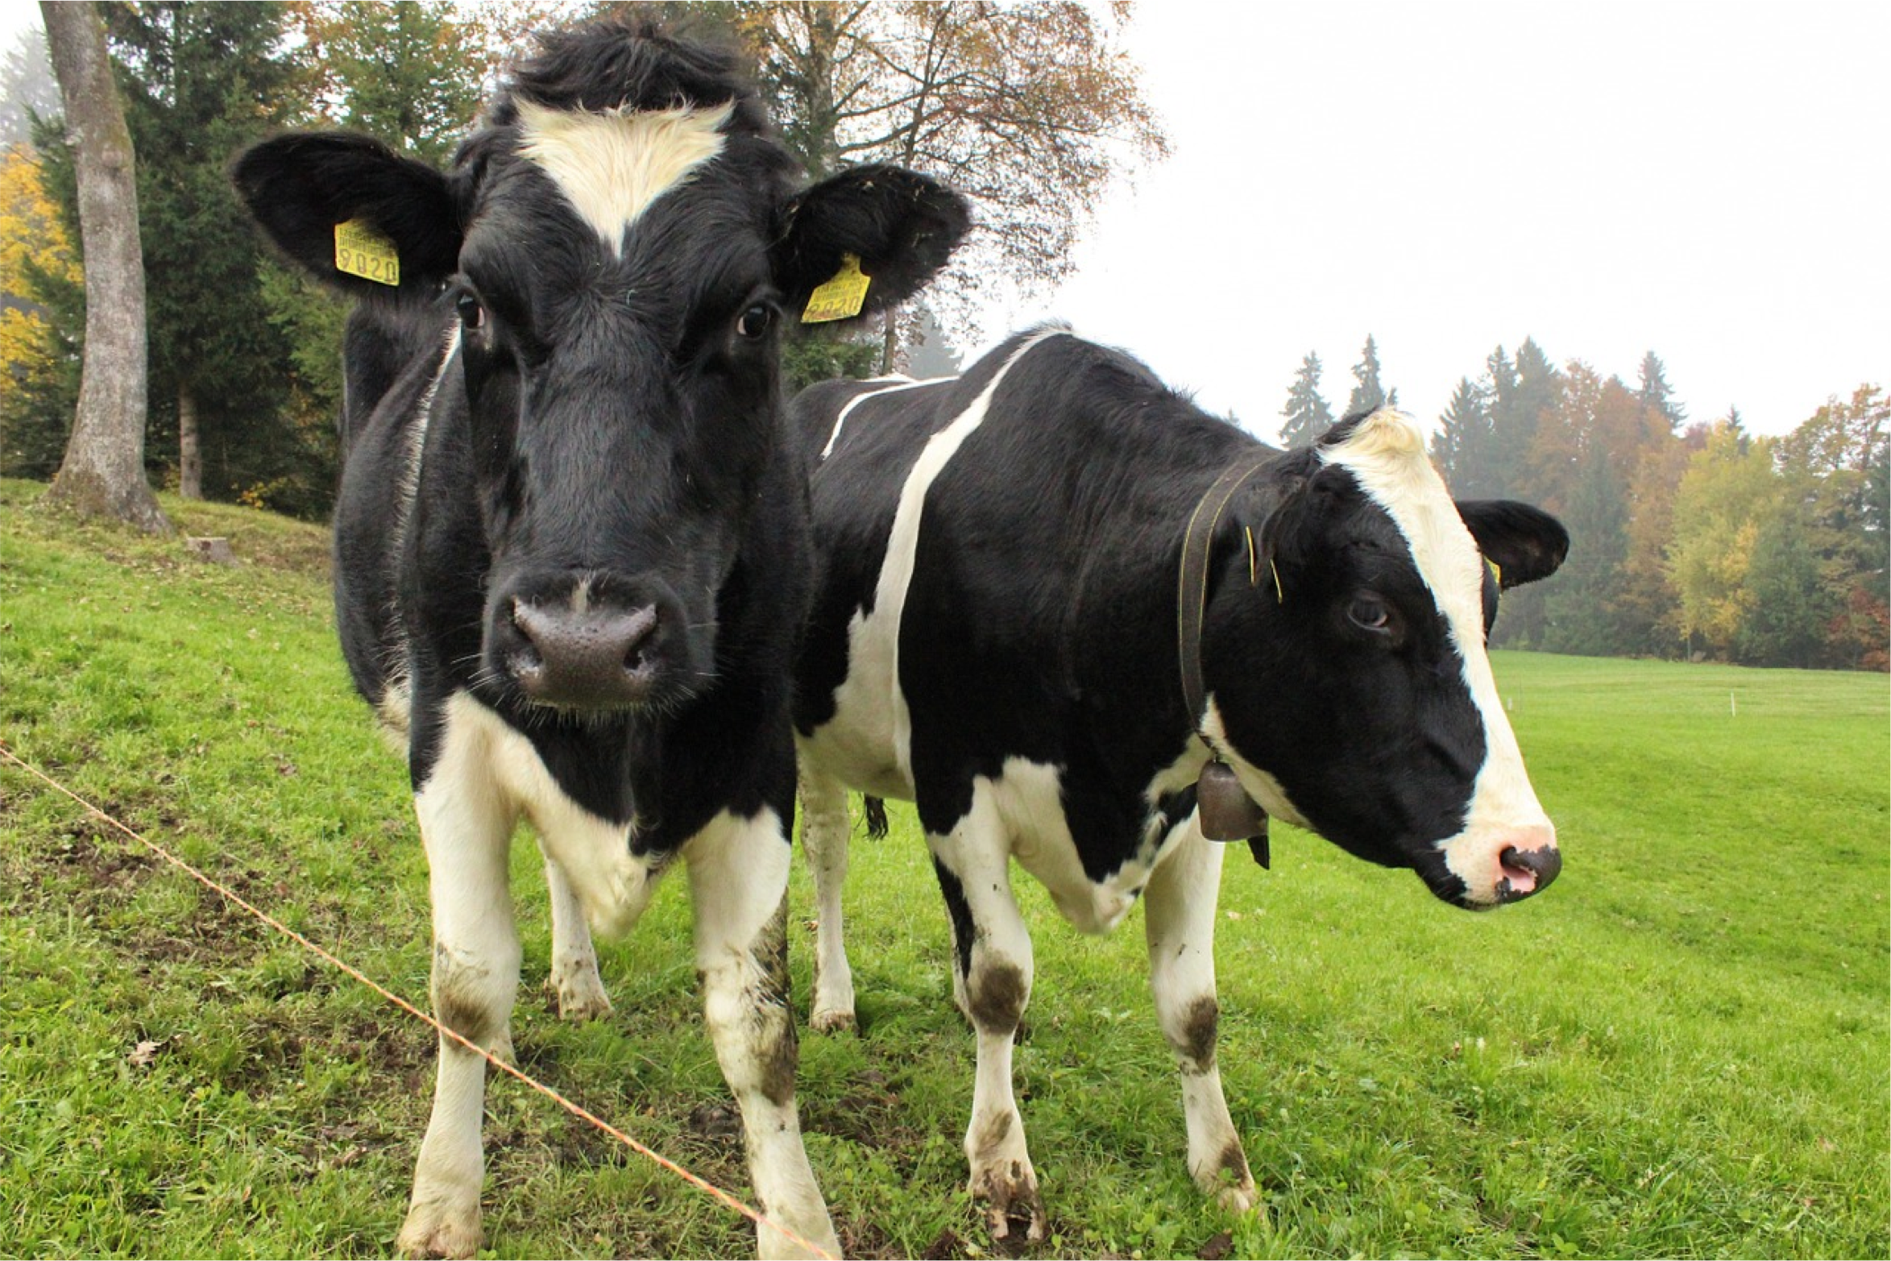
Computer Vision Tasks: Instance Segmentation
Instance Segmentation:
Cow
Detect all objects in the image, and identify the pixels that belong to each object (Only things!)
Cow
Approach: Perform object detection, then predict a segmentation mask for each object!

Slide 18
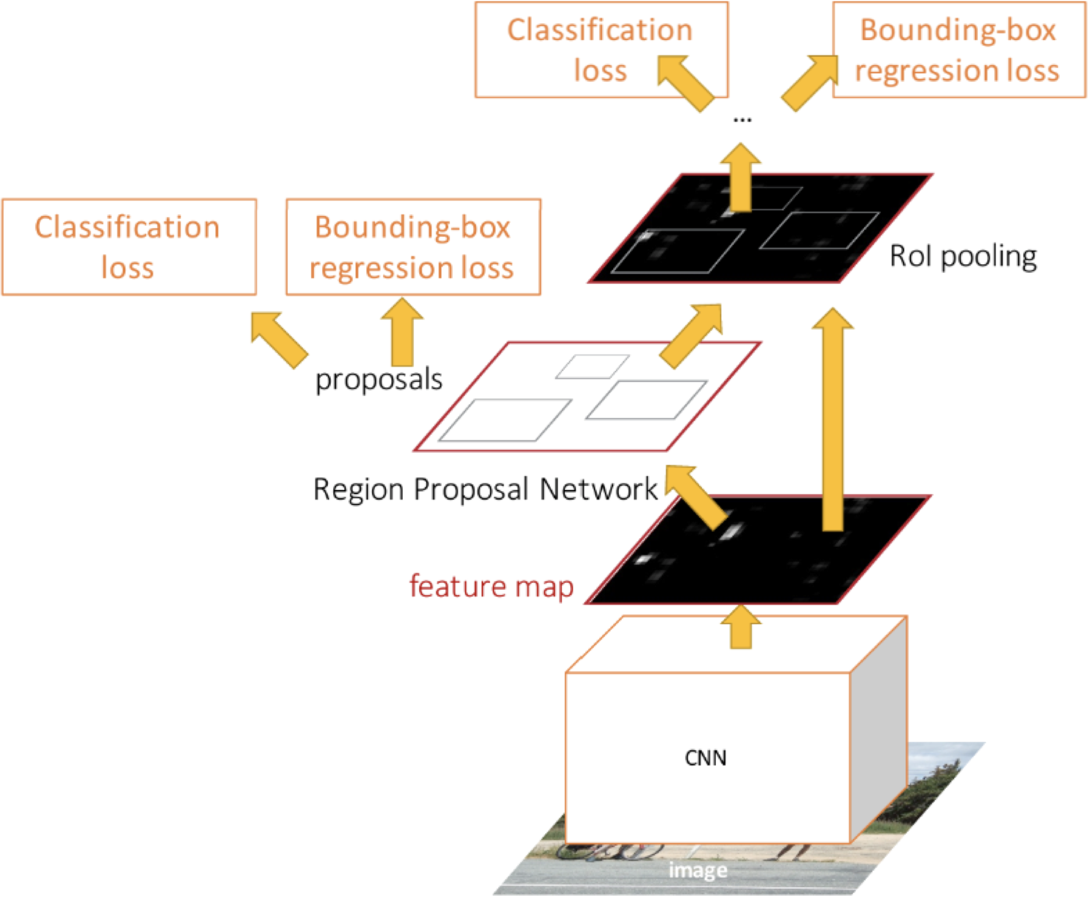
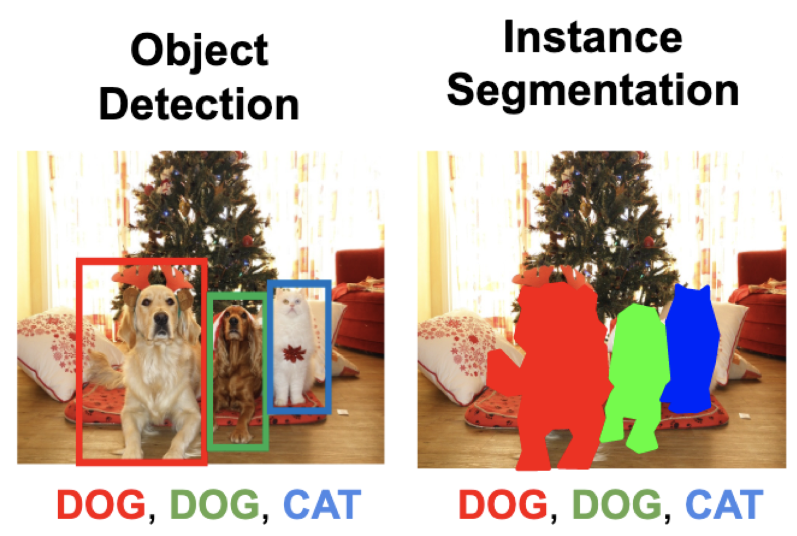
Instance Segmentation: Mask R-CNN
Mask Prediction

Slide 19
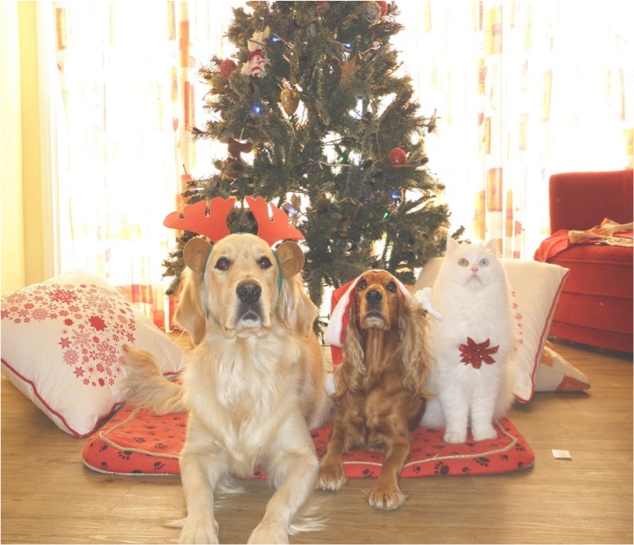
Mask R-CNN
Classification Scores: C
Box coordinates (per class): 4 * C
CNN
+RPN
Conv Conv
256 x 14 x 14
RoI Align
256 x 14 x 14

Slide 20
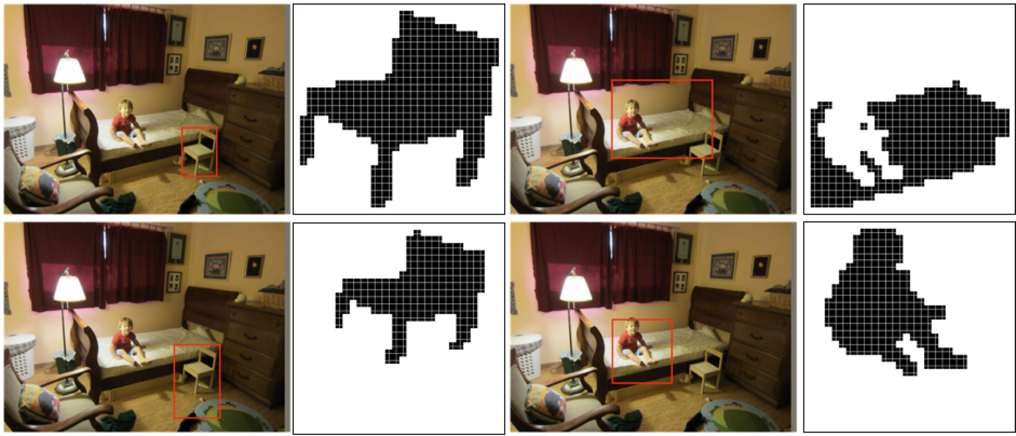
Mask R-CNN: Example Training Targets

Slide 21
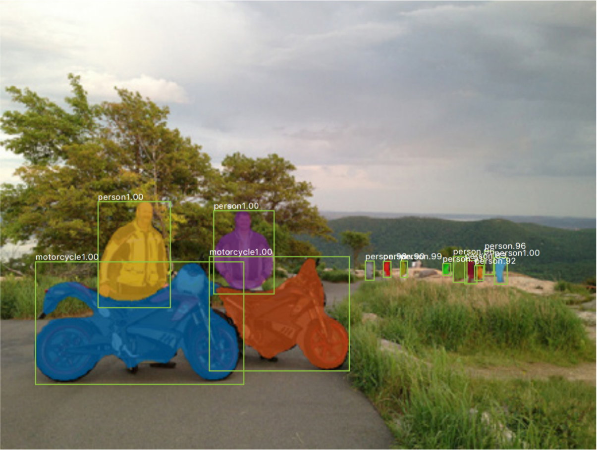
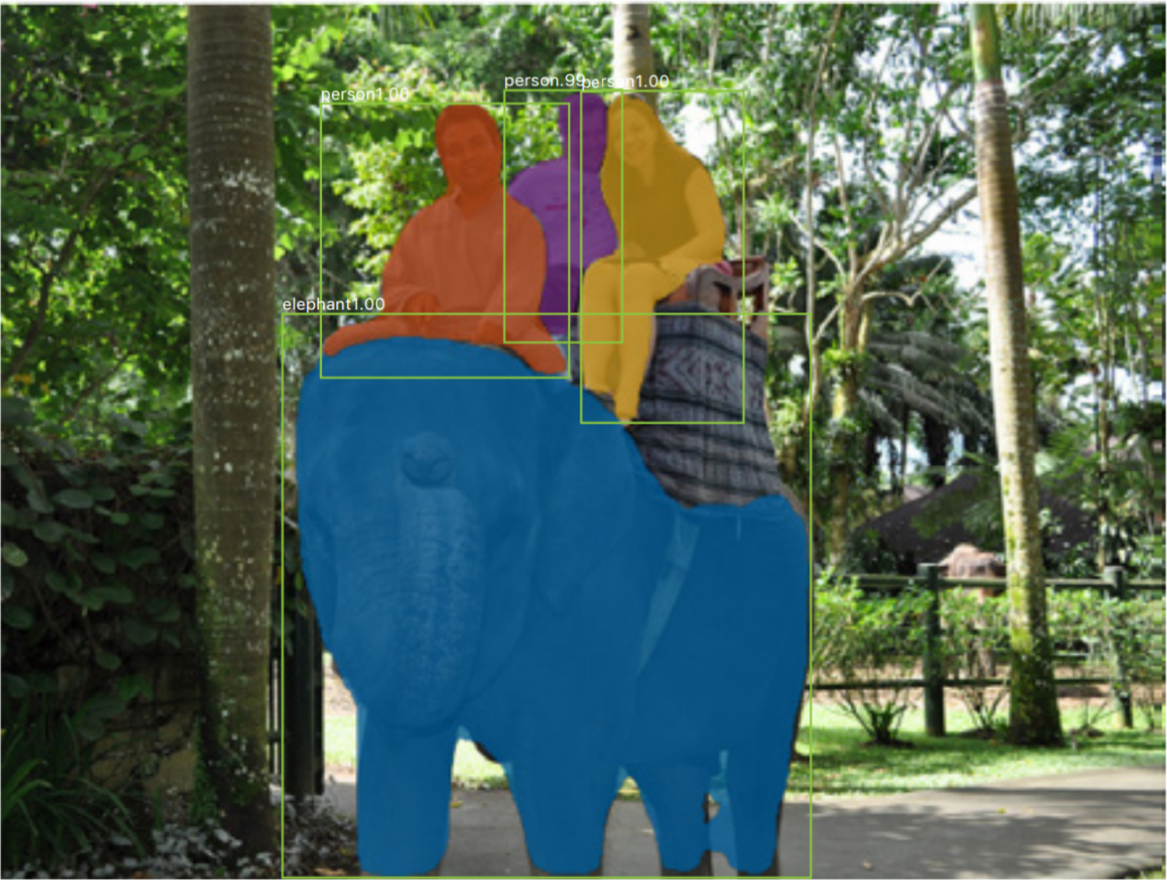
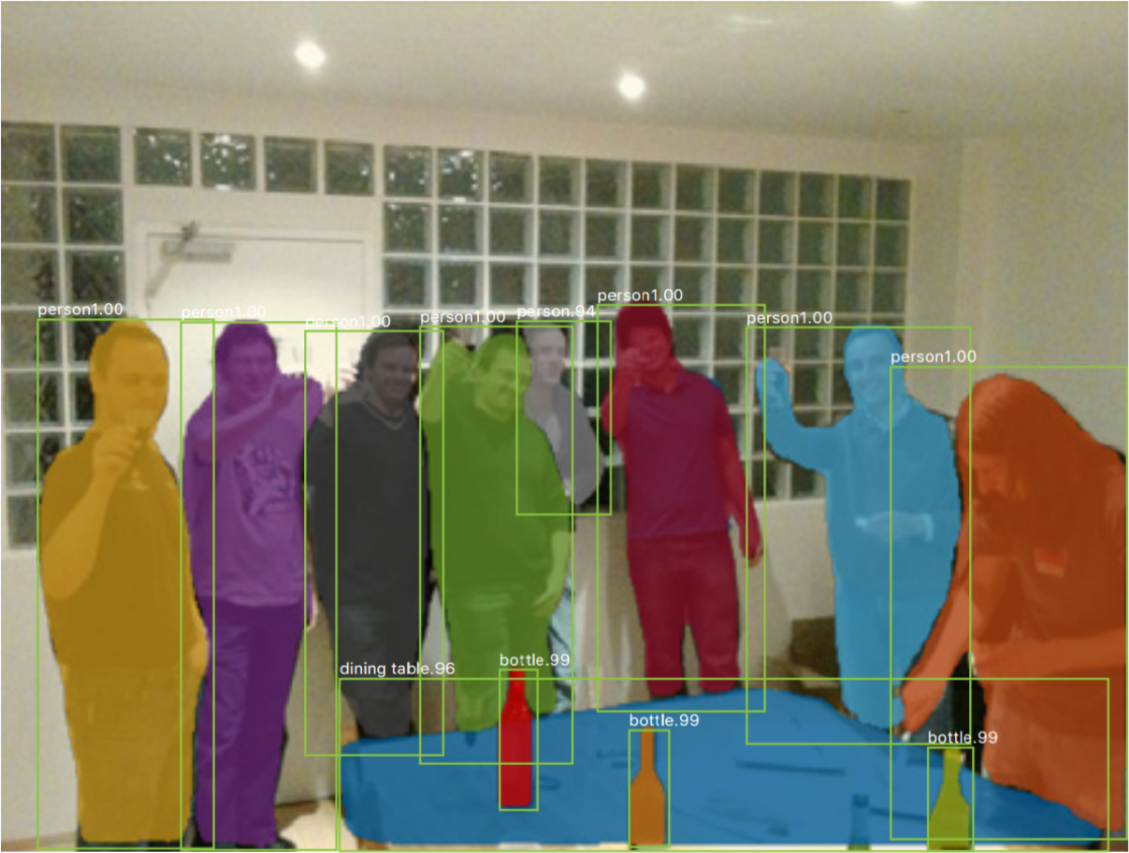
Mask R-CNN: Very Good Results!

Slide 22

Beyond Instance Segmentation: Panoptic Segmentation
Label all pixels in the image (both things and stuff)
Sky
Trees
Cow #1
Cow #1
For “thing” categories also separate into instances
Cow #2
Grass
Kirillov et al, “Panoptic Segmentation”, CVPR 2019
Kirillov et al, “Panoptic Feature Pyramid Networks”, CVPR 2019

Slide 23
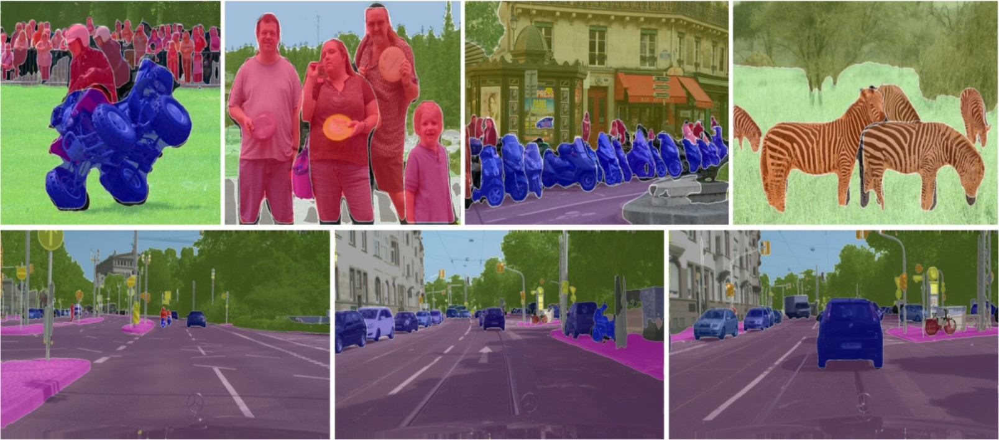
Beyond Instance Segmentation: Panoptic Segmentation
Kirillov et al, “Panoptic Feature Pyramid Networks”, CVPR 2019

Slide 24
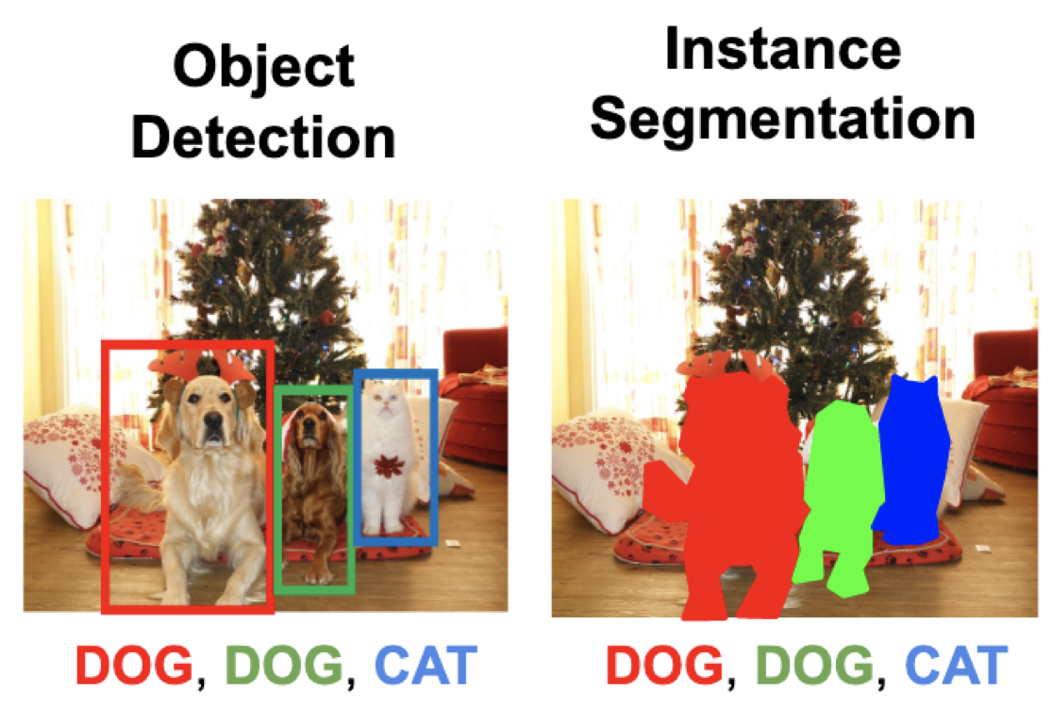

Mask R-CNN: Keypoint Estimation
Mask Prediction
Keypoint prediction
Keypoint estimation

Slide 25
Mask R-CNN: Keypoints
Classification Scores: C
Box coordinates (per class): 4 * C Segmentation mask: C x 28 x 28
One mask for each of the K different keypoints
Left ankle Right ankle
…
CNN
+RPN
Conv…
RoI Align
Keypoint masks: K x 56 x 56
Ground-truth has one “pixel” turned on per keypoint. Train with softmax loss
256 x 14 x 14
He et al, “Mask R-CNN”, ICCV 2017

Slide 26
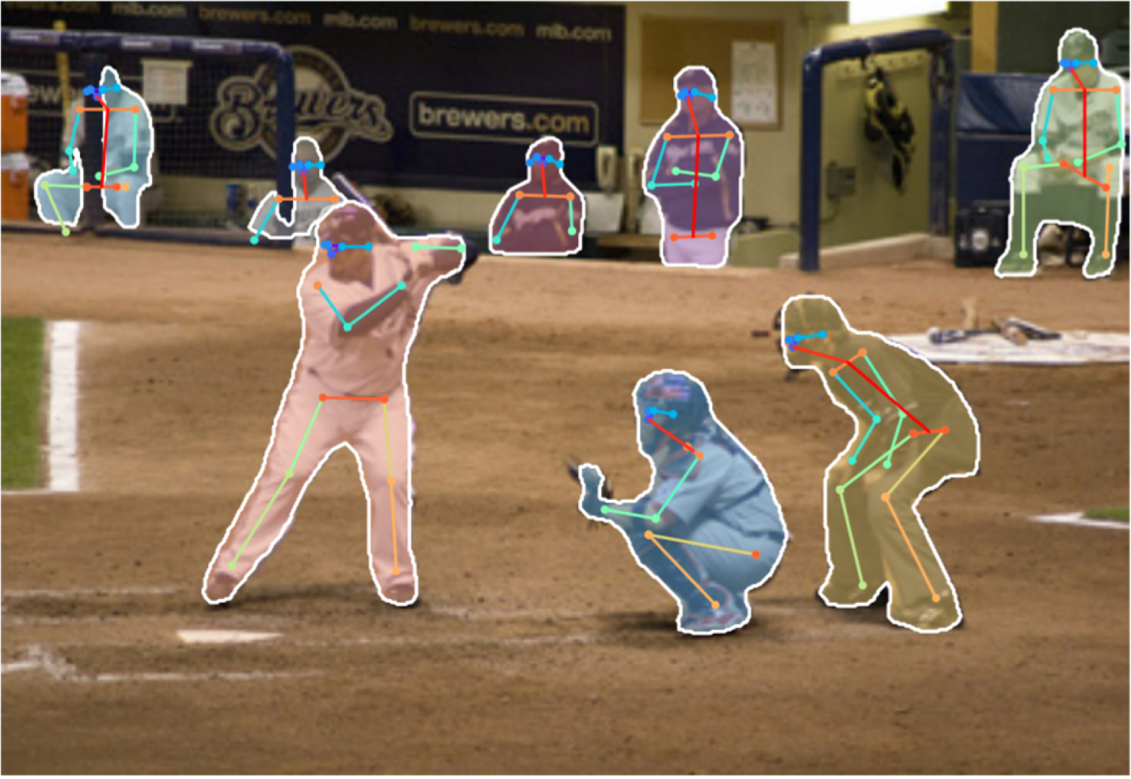
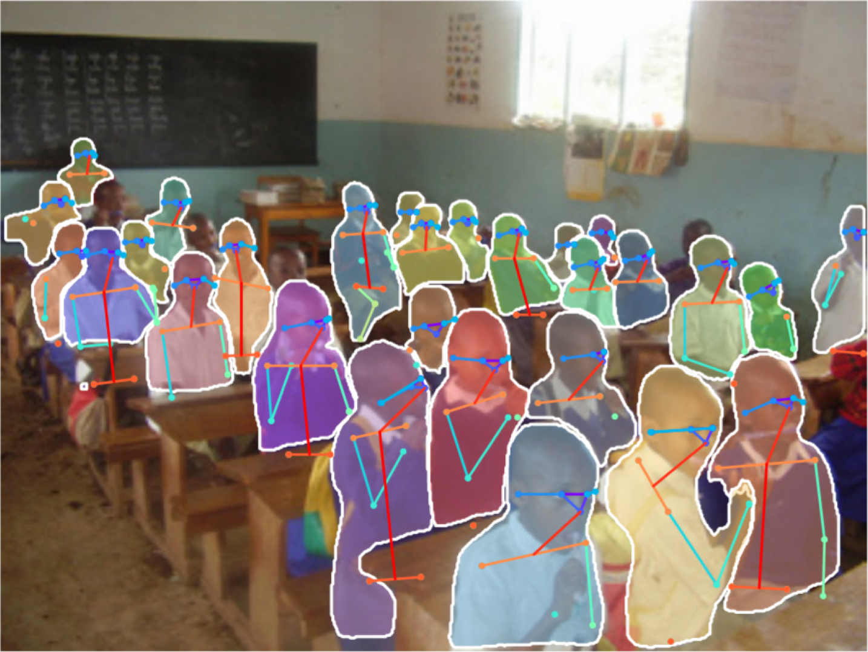
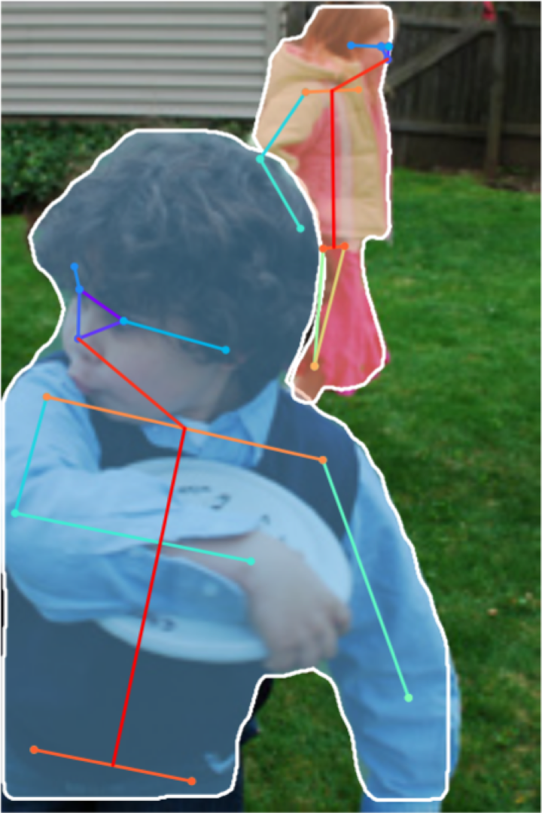
Joint Instance Segmentation and Pose Estimation

Slide 27
General Idea: Add Per- Region “Heads” to Faster / Mask R-CNN!
Mask Prediction
Keypoint prediction
Per-Region Heads:
Each receives the features after
RoI Pool / RoI Align, makes some prediction per-region
Keypoint estimation

Slide 28
Dense Captioning: Predict a caption per region!
Caption prediction (LSTM)
Per-Region Heads:
Each receives the features after
RoI Pool / RoI Align, makes some prediction per-region
Johnson, Karpathy, and Fei-Fei, “DenseCap: Fully Convolutional
Localization Networks for Dense Captioning”, CVPR 2016

Slide 29
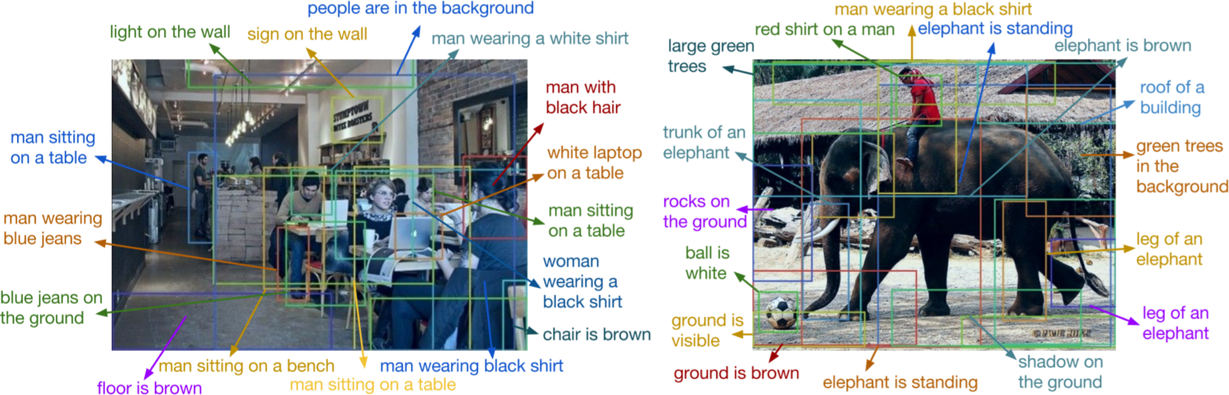
Dense Captioning

Slide 30
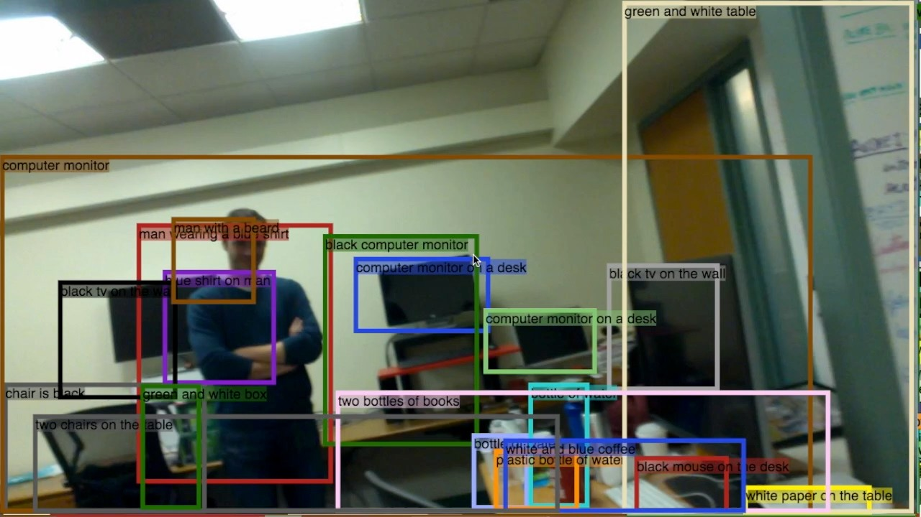
Dense Captioning

Slide 31
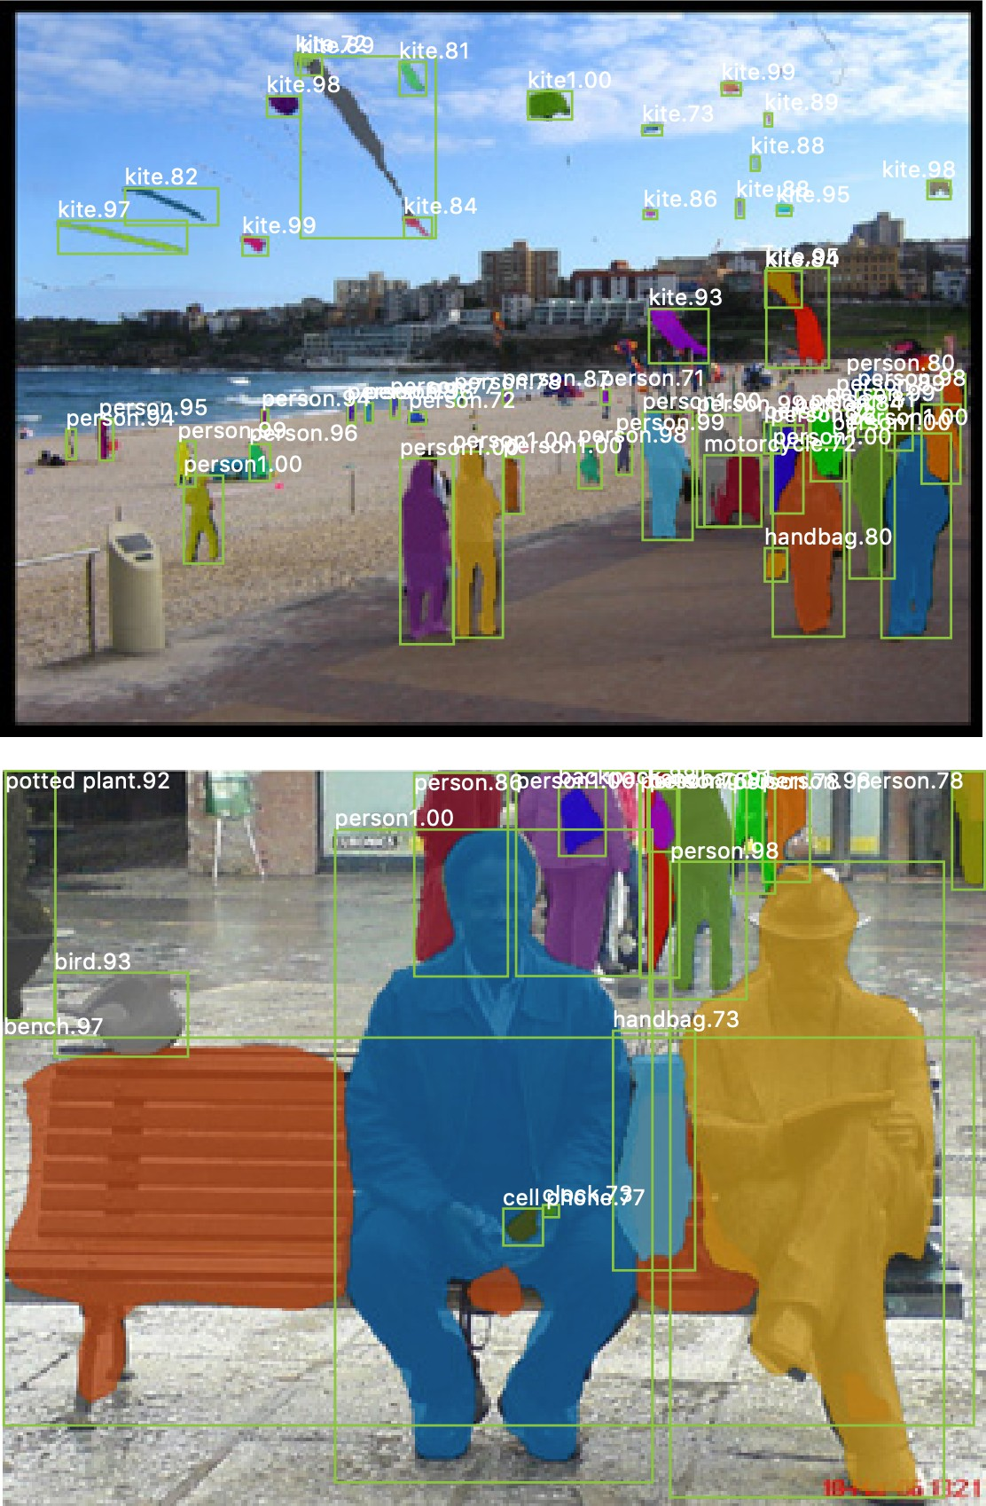
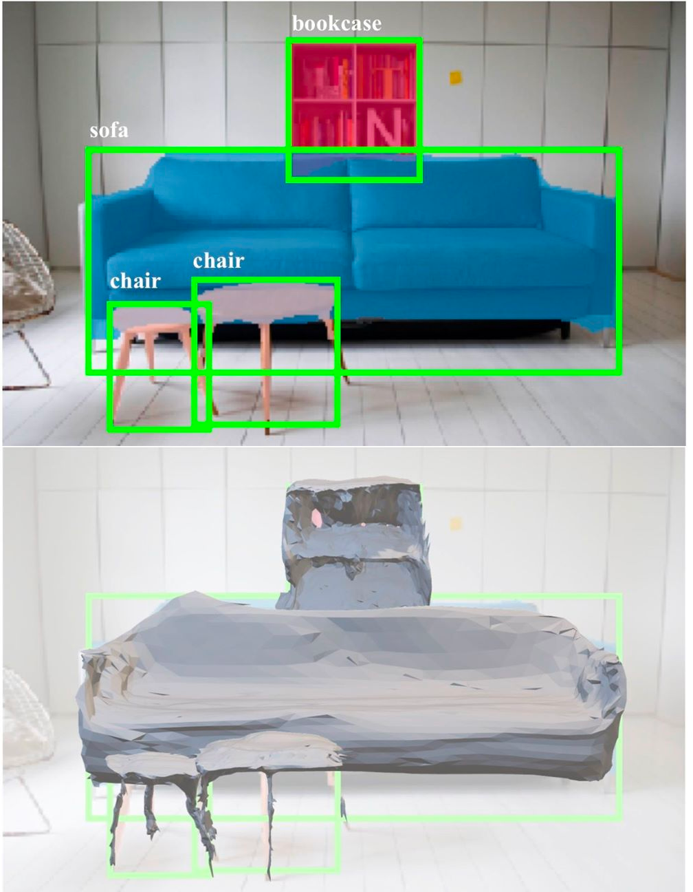
3D Shape Prediction: Mask R-CNN + Mesh Head
Mask R-CNN:
2D Image -> 2D shapes
Mesh R-CNN:
2D Image -> 3D shapes
More details next time!
He, Gkioxari, Dollár, and Girshick, “Mask R-CNN”, ICCV 2017
Gkioxari, Malik, and Johnson, “Mesh R-CNN”, ICCV 2019

Slide 32


